Slide 1

Trust By Design
Designing a DPDP–Complaint Student Data Consent Experience for Vedantu
“Product Management Internship Assignment”
Making privacy simple, transparent, and complaint for every student and parent.
“Prepared by”
Mashrufa Mondal

Slide 2

Problem Statement
The Problem
Vedantu collects student data to deliver personalized learning experiences, including:
Student Profiles
Attendance Records
Class Recordings
Test Scores
AI-Based Learning Recommendations
However, parents and students often lack visibility into:
What data is collected
Why it is collected
Who can access it
How long it is stored
How consent can be withdrawn
Student Data
Vedantu Platform
Parent
Teacher
AI
Design Challenge: How might Vedantu create a transparent, parent-friendly consent experience that complies with India's DPDP Act, 2023 while keeping onboarding simple and frictionless?

Slide 3
Understanding The User
Primary Persona
Priya Sharma
Age: 38
Role: Parent of a Grade 8 student
Occupation: Working Professional
Goals
✔️ Keep my child's data safe
✔️ Understand why Vedantu collects data
✔️ Easily manage my consent
Pain Points
❌ Privacy policies are difficult to understand
❌ No clear visibility into data collection
❌ Unsure who can access my child's information
User Needs:
🛡️ Transparency: Tell me what data is collected and why.
⚙️ Control: Let me manage my consent anytime.
🤝 Trust: Keep my child's information secure.
Parent
Priya Sharma
Age: 38
Tech Comfort:⭐⭐⭐⭐☆
Trust Level:⭐⭐⭐☆☆
Uses Vedantu: Daily

Slide 4
Current Experience
Student Signs Up Accepts Terms &Privacy Policy Data Collected Personalized Learning No Easy Consent Control
Current Pain Points:
🔍 Low Transparency:
Parents don't know what data is collected.
❌ One-time Consent:
Consent is taken once and is difficult to review or withdraw.
⚠️ Limited User Control:
No centralized Privacy Dashboard to manage permissions.
DPDP Compliance Gaps
Generic privacy policy
Limited consent visibility
No easy consent withdrawalNo consent history

Slide 5
Proposed Solution
1. Privacy Dashboard
View collected data
View purpose of data collection
Manage permissions
Download personal data
Delete account/request data deletion
2. Granular Consent
Instead of one "Accept All" button, parents can choose:
Attendance Data
Test Scores
AI Recommendations
Marketing Emails
Each consent can be turned ON/OFF independently.
3. Consent Timeline
Sign Up
Parent Verification
Choose Data Permissions
Learning Begins
Privacy Dashboard Available Anytime
Key Benefits
Transparent Parent – Friendly DPDP Complaint Easy to Update Anytime

Slide 6
Measuring Success
North Star Metric
Percentage of active student accounts with valid, up-to-date parental consent.
Target: 95% within 3 months of launch.
Consent completion rate → 90%+
Privacy Dashboard usage → 40% of parents/month
Data deletion & download requests resolved within 7 days
Supporting Metrics
Onboarding drop-off should remain below 5%
Privacy-related support tickets should decrease by 30%
Parent satisfaction (CSAT) for privacy experience should reach 4.5/5
Guardrail Metrics
Success Criteria
The solution is successful if it:
Increases parent trust.
Meets DPDP compliance requirements.
Maintains a smooth onboarding experience.
Improves transparency without reducing student enrollment.

Slide 7
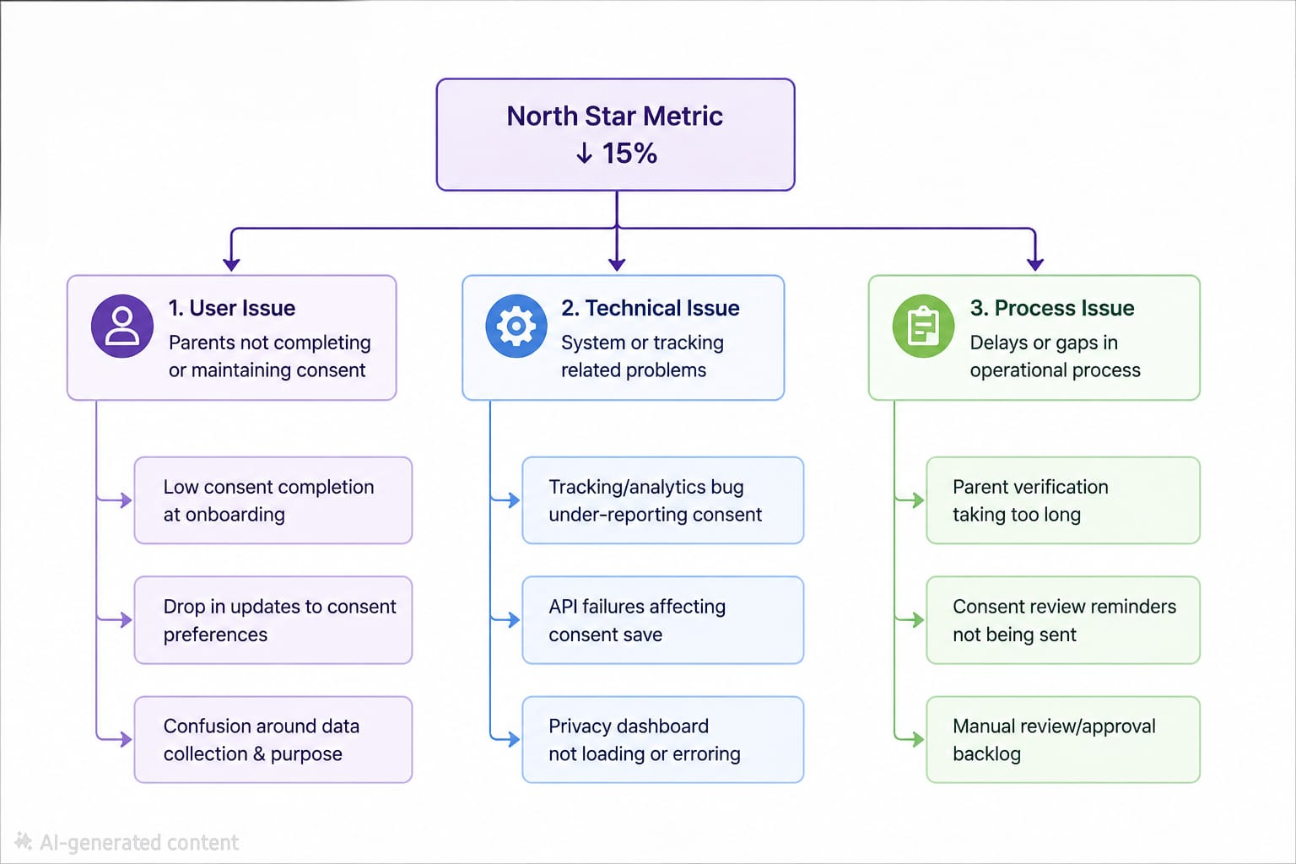
Diagnostic Thinking
Scenario
Three weeks after launch, the North Star Metric drops by 15%, even though no major product release happened.
Question: What happened, and how would we investigate it?
Hypothesis Tree
Data to Analyze
Key Metrics
Consent completion by platform (Android/iOS/Web)
Funnel drop-off by onboarding step
Parent verification success rate
Privacy dashboard usage
Error logs and support tickets
Next Steps
Identify the root cause
Roll back if it's a technical issue
Run user interviews if it's a UX issue
Monitor metrics daily after the fix

Slide 8
Dashboard design
Main KPI
North Star Metric
Valid Parent Consent Rate
94%
(Target: 95%)
Trend Over Time
Consent Rate (Last 4 Weeks)
Week 1 ▂
Week 2 ▅
Week 3 ▇
Week 4 █
Supporting Metrics
Consent Completion: 92%
Privacy Dashboard Usage: 43%
Data Requests Resolved: 96%
Parent CSAT: 4.6 / 5
Segmentation
By Platform:
Platform Consent
Android 95%
iOS 93%
Web 91%

Slide 9
Rollout Plan
Layout
Design → Pilot → Validate → Full Launch
Step 1 – Design (Week 1–2)
Build & Test
Finalize Privacy Dashboard
Design new consent flow
Internal QA testing
Step 2 – Pilot (Week 3–4)
Limited Rollout
Release to 10% of new users
Collect feedback from parents
Monitor consent completion
Step 3 – Validate (Week 5)
Measure Results
Review North Star Metric
Analyze onboarding drop-off
Check support tickets & CSAT
Step 4 – Full Launch (Week 6)
100% Rollout
Launch to all users
Continue monitoring dashboard
Weekly compliance review
A/B Testing Approach
✅ Test only UI elements such as:
Button text
Card layout
Help text
❌ Do not A/B test legal compliance features (such as whether consent is required), because these must remain consistent for all users.

Slide 10
Risks and Trade-offs
Layout
Trade-offs
Accepted Trade-offs
Prioritize trust over faster onboarding.
Collect only necessary personal data.
Allow users to manage consent anytime.
Maintain full DPDP compliance, even if it adds an extra onboarding step.
Risks
🛠️ Engineering Complexity
Building a Privacy Dashboard, consent logs, and parent verification requires additional development effort.
📉 Business Impact
Adding consent steps may slightly reduce onboarding conversion in the short term.
👥 User Adoption
Some parents may skip or misunderstand privacy settings, requiring clearer guidance.
⚠️ Edge Cases
Handling consent withdrawal, child accounts, and data deletion requests increases operational complexity.
Final Takeaway
Privacy should not feel like a legal obligation—it should feel like a product feature that builds trust. By making consent transparent, granular, and easy to manage, Vedantu can strengthen parent confidence while remaining fully compliant with India's DPDP Act, 2023.
Prototype
https://www.figma.com/proto/99Z7IQkUMrQziNEGUtalQ7/Untitled?page-id=0%3A1&node-id=1-2&viewport=-409%2C156%2C0.53&t=ZlWSYzJaHjdUqtDz-1&scaling=scale-down&content-scaling=fixed

